Slide 1

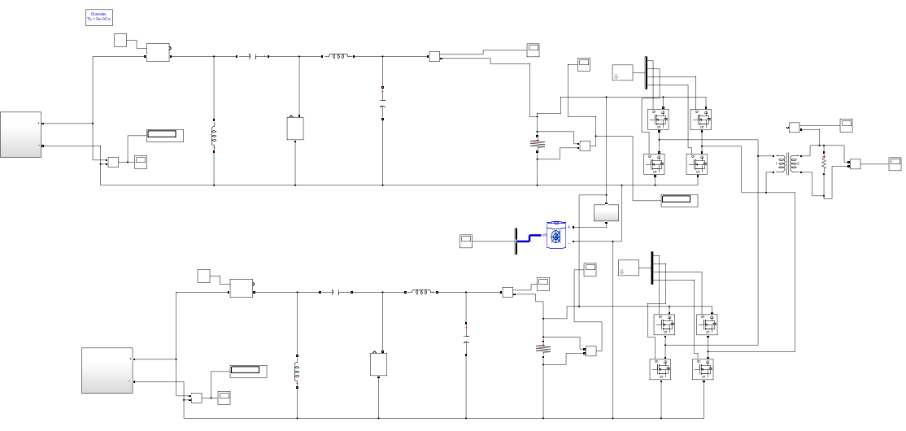
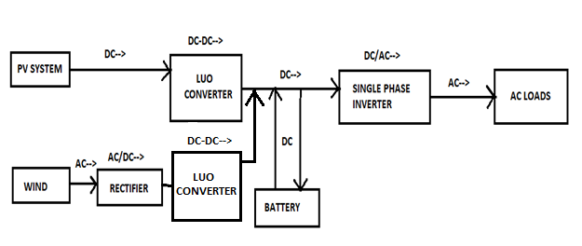
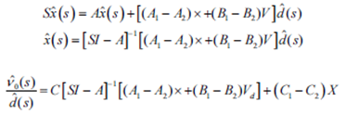
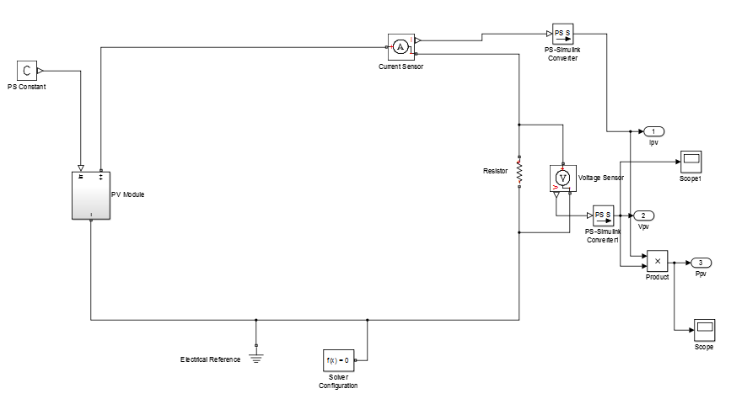
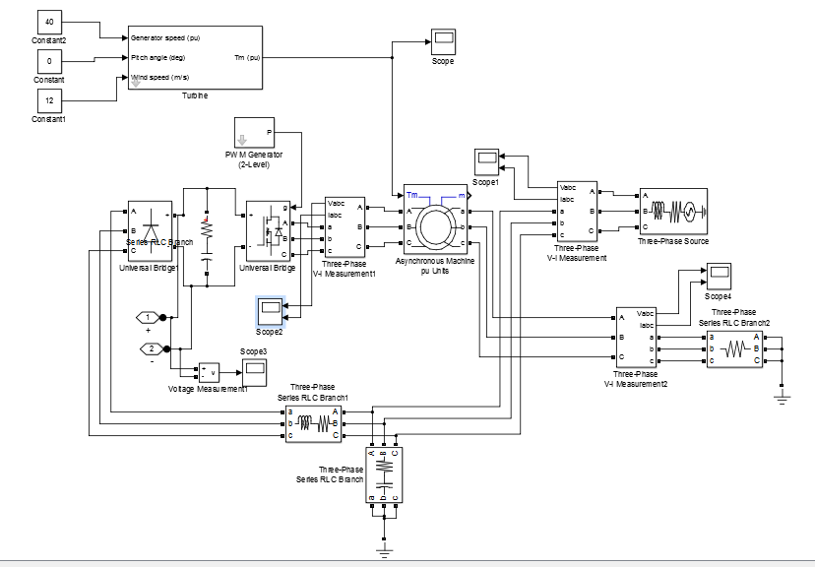
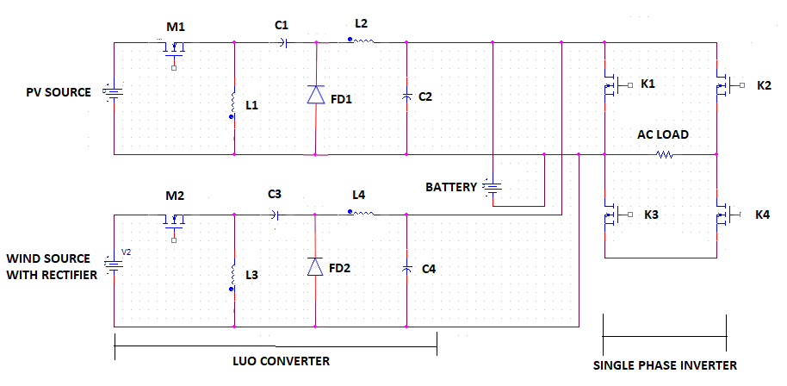
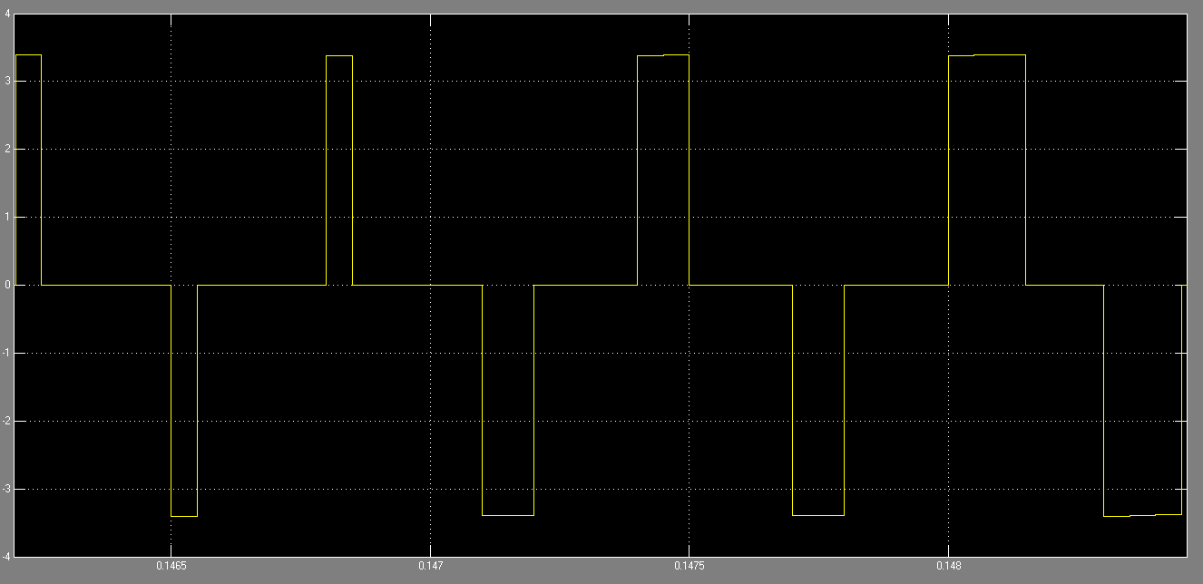
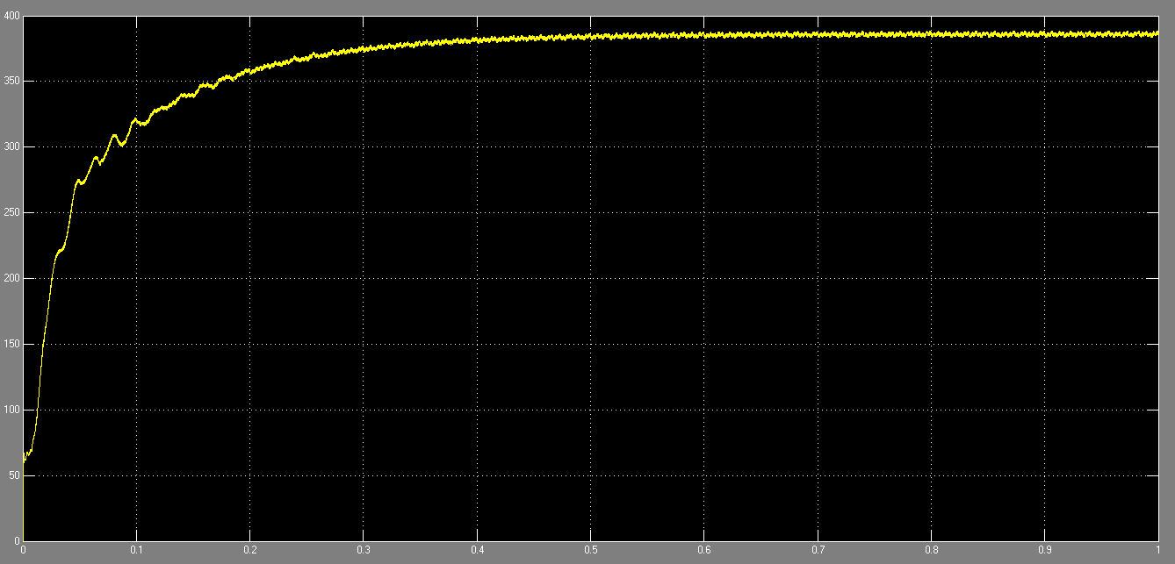
GRID CONNECTED PV WIND BATTERY COUPLED BIDIRECTIONAL
DC-DC LUO CONVERTER FOR HOUSEHOLD APPLIANCES
Sumit das, Gaurav singh and Devesh tripathi
Pursuing B.tech from S.R.M Institute of technology Faculty Advisor: B.Vinothkumar
AIM OF THE PROJECT
SIMULATION AND FORMULA
HARDWARE
To provide an uninterupted power supply using hybrid systems.
To satisfy the load demand.
To manage the power flow from different sources.
To inject the surplus power into the grid and charge the battery from the grid.
To make the project compact and to increase the efficiency.
In the hardware, the basic prototype is shown. The driver circuit is used to generate pulse and to use in mosfet for switching on and off. The optocoupler tlp250 is used in driver circuit. The dsPIC controller is used to transfer the pulse. Voltage regulator is used to convert 12V dc to 5V dc for dsPIC controller to transfer 5V pulse to driver circuit.
HARDWARE DETAILS
COMPONENTS | RATING AND USAGE
PV PANEL | 12V 5W DC
WIND MODULE | 12V AC
TLP250 | DRIVER IC
dsPIC30F2010 | CONTROLLER
DIODE | IN4007
CAPACITOR | 470MF
LED(LOAD) | 3.3V-4
INDUCTOR | 100MH
VOLTAGE REGULATOR | 7805
MODELLING
SIMULATION
CONCLUSION
In this simulation,the modelling of solar and wind system is accomplished. the photovoltaic powe rating is 70W. The output of solar is 70V and 1A. The simulation consist of a luo converter which is a proposed system of our project. To convert the DC voltage to AC single phase bridge rectifier is used. Below this there is a modelling of wind and solar system which harness a low amount of output. The output of Pv and Wind is increased by luo converter in a ratio of 1:7.
A grid-connected hybrid PV–wind-battery-based power evacuation scheme for household application is proposed. The proposed hybrid system provides an elegant integration of PV and wind source to extract maximum energy from the two sources. It is realized by a DC-DC luo converter followed by a conventional singlr phase full-bridge inverter. A versatile control strategy which achieves a better utilization of PV, wind power, battery capacities without effecting life of battery, and power ﬂow management in a grid-connected hybrid PV–wind-battery-based system feeding ac loads is presented. Detailed simulation studies are carried out to ascertain the viability of the scheme. The experimental results obtained are in close agreement with simulations and are supportive in demonstrating the capability of the system to operate either in grid feeding or in stand-alone modes. The proposed conﬁguration is capable of supplying uninterruptible power to ac loads, and ensures the evacuation of surplus PV and wind power into the grid.
LUO CONVERTER OUTPUT EQUATION
BLOCK DIAGRAM
PV SYSTEM
WIND MODELLING
RESULTS
CIRCUIT DIAGRAM
The circuit diagram consist of a PV source , wind source and a battery as a power bank. There are two luo converters for PV as well as wind separately. Mosfets are used as a triggering switch. Inductors and capacitors are used for charging and discharging purpose. To convert dc to ac single phase full bridge inverter is used to supply power to the ac load. The input of photovoltaic cell is sun light and the output current and voltage is 1A and 69.9V. The input of wind is mechanical energy which is converted into electrical energy. The output voltage of wind energy is around 145V and converter output is 390V. Asynchronous generator is used to convert mechanical energy into electrical energy. The load which we are using is resistive load.
The overall output waveforms of the project is shown here. The output voltage is 388V and the output current is 3.8A. Overall power rating is 1474W. To satisfy the load demand step down transformer is used. The luo converter output is shown . It harness upto 388V and it also charges the battery as well it supplies power to loads.
OVERALL OUTPUT CURRENT
OVERALL OUTPUT VOLTAGE
LUO CONVERTER OUTPUT

